Slide 1
Minimum Spanning Tree
Course Code: CSC2211
Course Title: Algorithms
Dept. of Computer Science
Faculty of Science and Technology
Lecturer No: |  | Week No: | 11 | Semester:
Lecturer: | Name & email

Slide 2
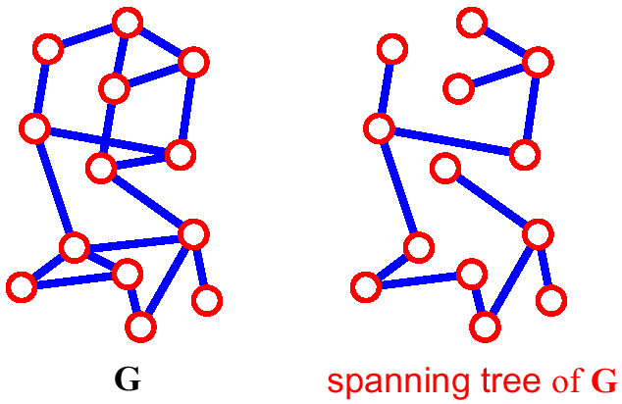
Spanning Tree.
A spanning tree of G is a subgraph which is a tree that
contains all vertices of G and no cycle.
If a graph G has v vertices and e number of edges, then a spanning tree of that graph will have n vertices and (n-1) number of edges.

Slide 3
Lecture Outline
Recalling Spanning Tree.
What is Minimum Spanning Tree (MST).
Applications of MST.
Algorithmic technique to find MST.
Kruskal’s Algorithm
Prim-Jarnik’s Algorithm.
Running time of Kruskal’s and Prim-Jarnik’s Algorithm.

Slide 4
Minimum Spanning Tree (MST)
Definition
A minimum spanning tree (MST) or minimum cost spanning
tree is a subset of the edges of a connected, weighted
undirected graph that connects all the vertices together,
without any cycles and with the minimum possible total
edge weight.

Slide 5
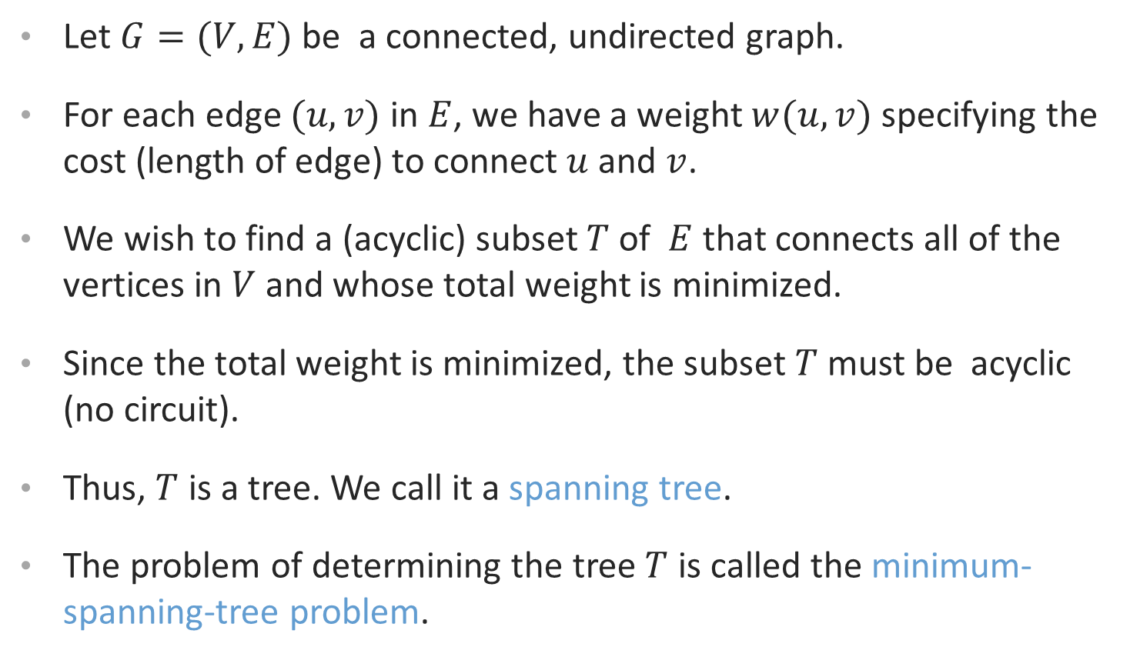
MST….
Let $G=(V,E)$ be a connected, undirected graph.
For each edge $(u,v)$ in $E$, we have a weight $w(u,v)$ specifying the cost (length of edge) to connect $u$ and $v$.
We wish to find a (acyclic) subset $T$ of $E$ that connects all of the vertices in $V$ and whose total weight is minimized.
Since the total weight is minimized, the subset $T$ must be acyclic (no circuit).
Thus, $T$ is a tree. We call it a spanning tree.
The problem of determining the tree $T$ is called the minimum-spanning-tree problem.

Slide 6
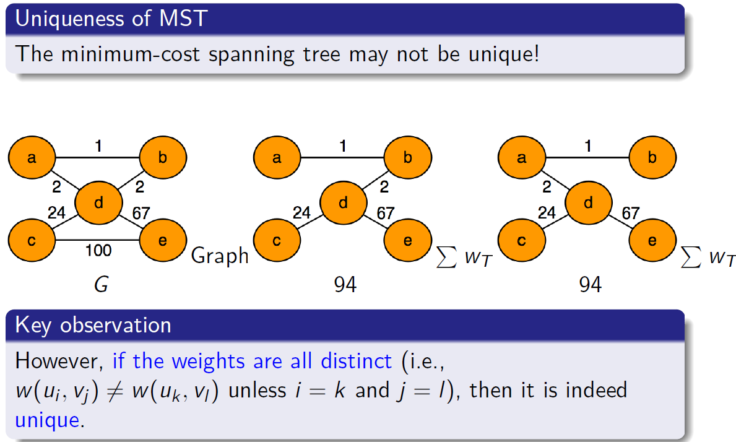
Minimum Spanning Tree (MST)

Slide 7
Application…..
In the design of electronic circuitry, it is often necessary to make a set of pins electrically equivalent by wiring them together.
To interconnect n pins, we can use n-1 wires, each connecting two pins.
We want to minimize the total length of the wires.
Minimum Spanning Trees can be used to model this problem.

Slide 8
Problem: Laying Telephone Wire
Central office

Slide 9
Wiring: Naïve Approach
Central office
Expensive!

Slide 10
Wiring: Better Approach
Central office
Minimize the total length of wire connecting the customers

Slide 11
Here is an example of a connected graph and its minimum spanning tree:
8
7
b
c
d
9
4
2
a
11
i
14
e
4
7
6
8
10
h
g
f
1
2
Notice that the tree is not unique:
replacing (b,c) with (a,h) yields another spanning tree with the same minimum weight.

Slide 12
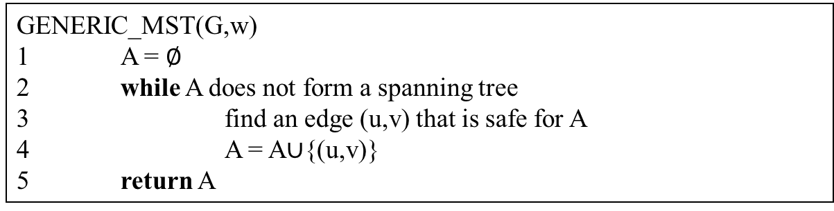
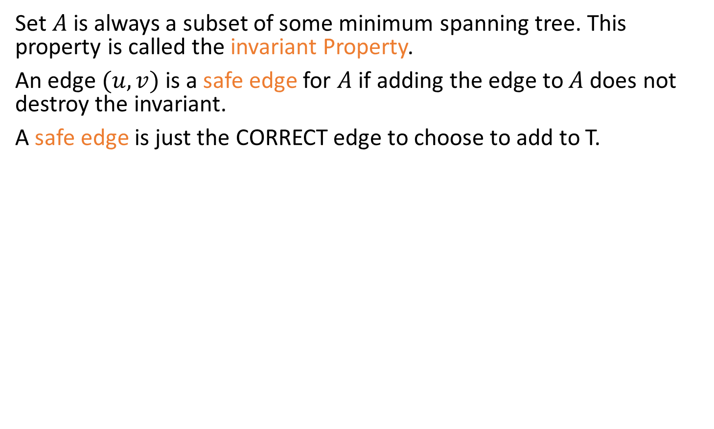
Growing a MST(Generic Algorithm)
Set $A$ is always a subset of some minimum spanning tree. This property is called the invariant Property.
An edge $(u,v)$ is a safe edge for $A$ if adding the edge to $A$ does not destroy the invariant.
A safe edge is just the CORRECT edge to choose to add to T.
GENERIC_MST(G,w)
1 A = $∅$
2 while A does not form a spanning tree
3 find an edge (u,v) that is safe for A
4 A = A∪{(u,v)}
5 return A

Slide 13
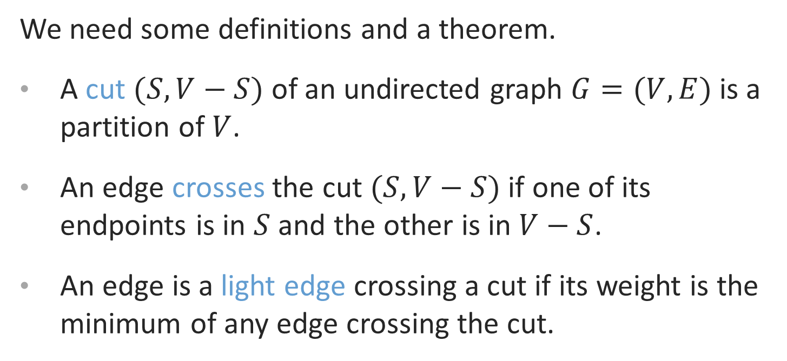
How to Find a Safe Edge
We need some definitions and a theorem.
A cut $(S,V−S)$ of an undirected graph $G=(V,E)$is a partition of $V$.
An edge crosses the cut $(S,V−S)$ if one of its endpoints is in $S$ and the other is in $V−S$.
An edge is a light edge crossing a cut if its weight is the minimum of any edge crossing the cut.

Slide 14
How to Find a Safe Edge
8
7
b
c
d
9
4
2
S↑
a
11
i
14
e
↑ S
4
7
6
8
10
V-S↓
h
g
f
↓ V-S
1
2
This figure shows a cut (S,V-S) of the graph.
The edge (d,c) is the unique light edge crossing the cut.

Slide 15
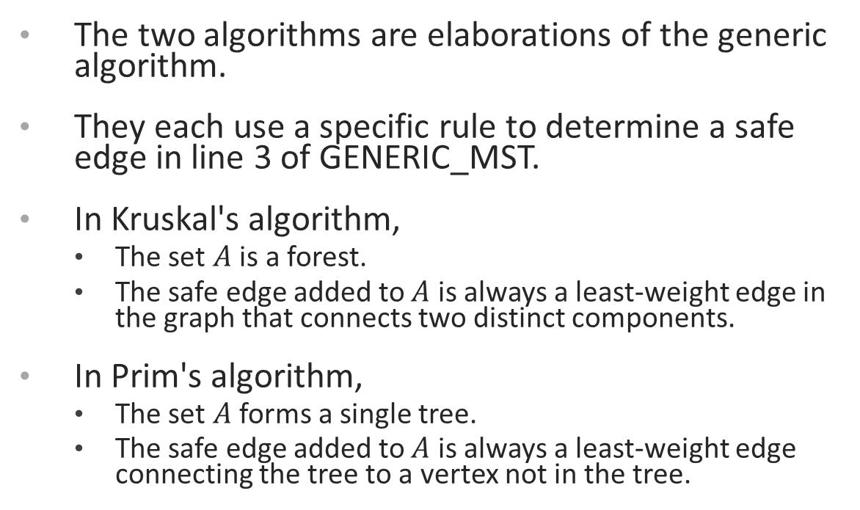
The Algorithms of Kruskal and Prim
The two algorithms are elaborations of the generic algorithm.
They each use a specific rule to determine a safe edge in line 3 of GENERIC_MST.
In Kruskal's algorithm,
The set $A$ is a forest.
The safe edge added to $A$ is always a least-weight edge in the graph that connects two distinct components.
In Prim's algorithm,
The set $A$ forms a single tree.
The safe edge added to $A$ is always a least-weight edge connecting the tree to a vertex not in the tree.

Slide 16
Related Topics
Disjoint-Set
Keep a collection of disjoint sets: S₁, S₂, .., S_{k},
Each S_{i} is a set, e,g, S₁={v₁, v₂, v₈}.
Three operations
Make-Set(x) - creates a new set whose only member is x.
Union(x, y) – unites the sets that contain x and y, say, S_{x} and S_{y}, into a new set that is the union of the two sets.
Find-Set(x) - returns a pointer to the representative of the set containing x.

Slide 17
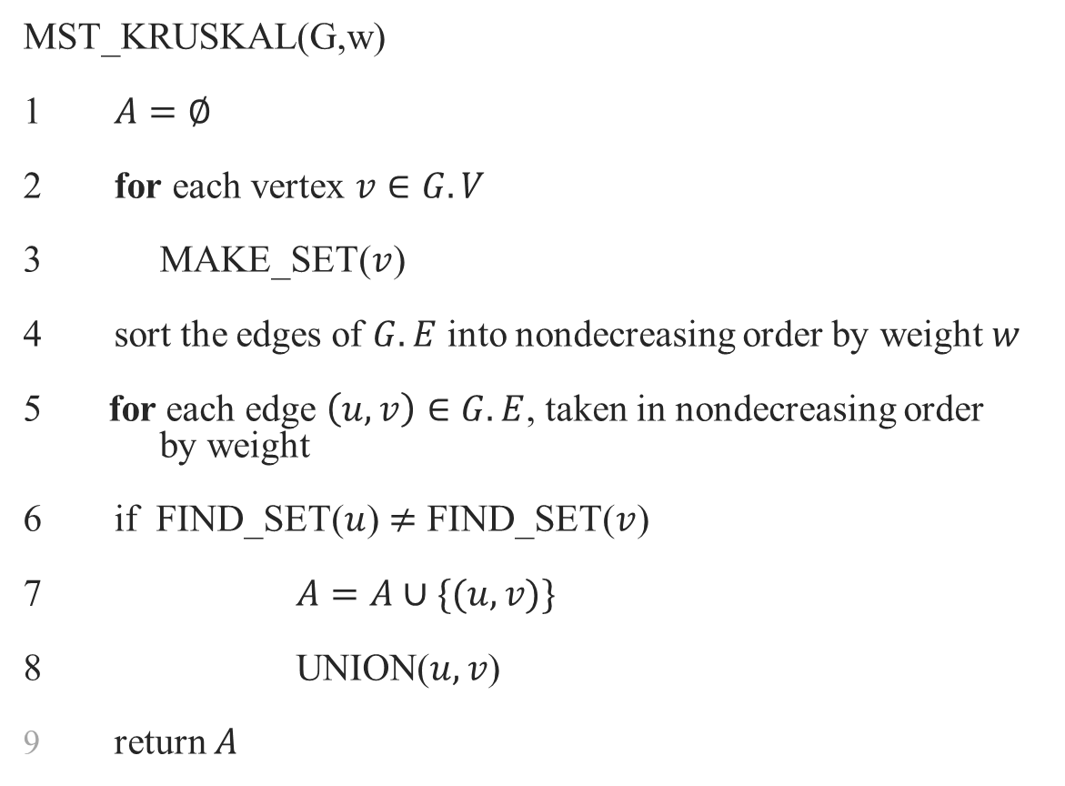
Kruskal's Algorithm
MST_KRUSKAL(G,w)
1 $A=∅$
2 for each vertex $v∈G.V$
3 MAKE_SET($v$)
4 sort the edges of $G.E$ into nondecreasing order by weight $w$
5 for each edge $\left(u,v\right)∈G.E$, taken in nondecreasing order by weight
6 if FIND_SET($u$) $≠$ FIND_SET($v$)
7 $A=A∪\{(u,v)\}$
8 UNION($u,v$)
return $A$

Slide 18
Kruskal’s algorithm
Basic idea:
Grow many small trees
Find two trees that are closest (i.e., connected with the lightest edge), join them with the lightest edge
Terminate when a single tree forms

Slide 19
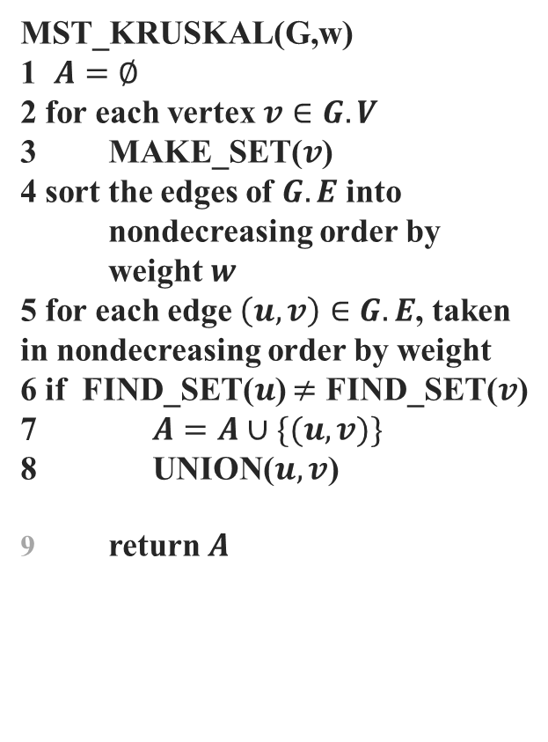
Time Complexity of Kruskal's Algorithm
MST_KRUSKAL(G,w)
1 $A=∅$
2 for each vertex $v∈G.V$
3 MAKE_SET($v$)
4 sort the edges of $G.E$ into nondecreasing order by weight $w$
5 for each edge $\left(u,v\right)∈G.E$, taken in nondecreasing order by weight
6 if FIND_SET($u$) $≠$ FIND_SET($v$)
7 $A=A∪\{(u,v)\}$
8 UNION($u,v$)
return $A$
Line 4 sorts E edges => it takes O(E lgE) time, if we use MergeSort
But lg E = O(lg V), since E < V² => lg E < 2 lg V => lg E is O(lg V)
Hence O(E lg E) = O(E lg V)
If we make total m calls of Make_set, Union, and Find_set in any algorithm, then these calls will take total O(m lg n) time, where n is the number of Make-Set calls.
The 1st for loop makes O(V) MAKE_SET() calls and the 2nd for loop makes O(E) Find_SET and UNION calls
Total O(V+E) calls of MAKE_SET, FIND_SET, and UNION, out of which O(V) calls were MAKE_SET calls => O((V+E) lgV) time
E ≥ V-1, since the graph is connected
=> V is O(E)=> O((V+E) lgV) = O(E lgV)
Hence total time = O(E lg V)

Slide 20
Kruskal's Algorithm: Example
The edges considered by the algorithm are sorted by weight.
The edge under consideration at each step is shown with a red weight number.
8
7
b
c
d
9
4
2
a
11
i
14
e
4
7
6
8
10
h
g
f
1
2

Slide 21
Kruskal's Algorithm: Example
The edges are considered by the algorithm in sorted order by weight.
The edge under consideration at each step is shown with a red weight number.
8
7
b
c
d
9
4
2
a
11
i
14
e
4
7
6
8
10
h
g
f
1
2

Slide 22
Kruskal's Algorithm: Example
The edges are considered by the algorithm in sorted order by weight.
The edge under consideration at each step is shown with a red weight number.
8
7
b
c
d
9
4
2
a
11
i
14
e
4
7
6
8
10
h
g
f
1
2

Slide 23
Kruskal's Algorithm: Example
The edges are considered by the algorithm in sorted order by weight.
The edge under consideration at each step is shown with a red weight number.
8
7
b
c
d
9
4
2
a
11
i
14
e
4
7
6
8
10
h
g
f
1
2

Slide 24
Kruskal's Algorithm: Example
The edges are considered by the algorithm in sorted order by weight.
The edge under consideration at each step is shown with a red weight number.
8
7
b
c
d
9
4
2
a
11
i
14
e
4
7
6
8
10
h
g
f
1
2

Slide 25
Kruskal's Algorithm: Example
The edges are considered by the algorithm in sorted order by weight.
The edge under consideration at each step is shown with a red weight number.
8
7
b
c
d
9
4
2
a
11
i
14
e
4
7
6
8
10
h
g
f
1
2

Slide 26
Kruskal's Algorithm: Example
The edges are considered by the algorithm in sorted order by weight.
The edge under consideration at each step is shown with a red weight number.
8
7
b
c
d
9
4
2
a
11
i
14
e
4
7
6
8
10
h
g
f
1
2

Slide 27
Kruskal's Algorithm: Example
The edges are considered by the algorithm in sorted order by weight.
The edge under consideration at each step is shown with a red weight number.
8
7
b
c
d
9
4
2
a
11
i
14
e
4
7
6
8
10
h
g
f
1
2

Slide 28
Kruskal's Algorithm: Example
The edges are considered by the algorithm in sorted order by weight.
The edge under consideration at each step is shown with a red weight number.
8
7
b
c
d
9
4
2
a
11
i
14
e
4
7
6
8
10
h
g
f
1
2

Slide 29
Kruskal's Algorithm: Example
The edges are considered by the algorithm in sorted order by weight.
The edge under consideration at each step is shown with a red weight number.
8
7
b
c
d
9
4
2
a
11
i
14
e
4
7
6
8
10
h
g
f
1
2

Slide 30
Kruskal's Algorithm: Example
The edges are considered by the algorithm in sorted order by weight.
The edge under consideration at each step is shown with a red weight number.
8
7
b
c
d
9
4
2
a
11
i
14
e
4
7
6
8
10
h
g
f
1
2

Slide 31
Kruskal's Algorithm: Example
The edges are considered by the algorithm in sorted order by weight.
The edge under consideration at each step is shown with a red weight number.
8
7
b
c
d
9
4
2
a
11
i
14
e
4
7
6
8
10
h
g
f
1
2

Slide 32
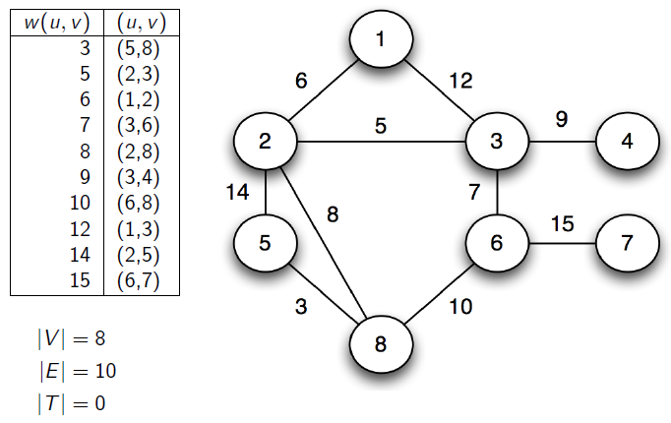
Kruskal’s algorithm in action

Slide 33
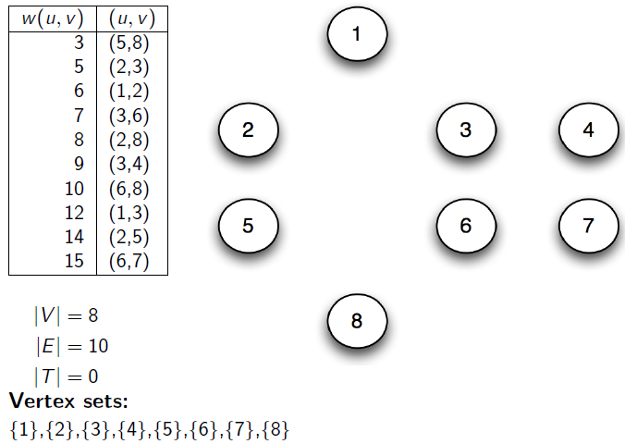
Kruskal’s algorithm in action

Slide 34
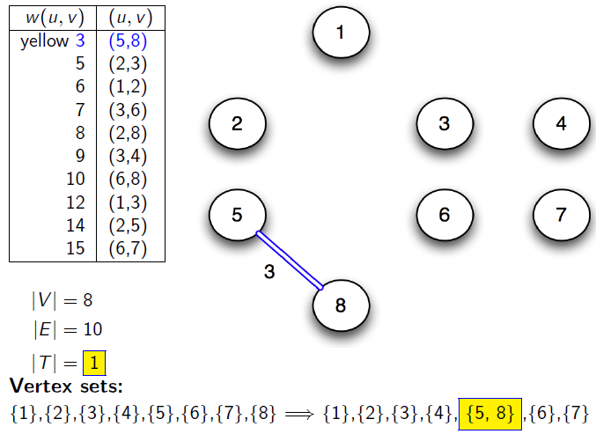
Kruskal’s algorithm in action

Slide 35
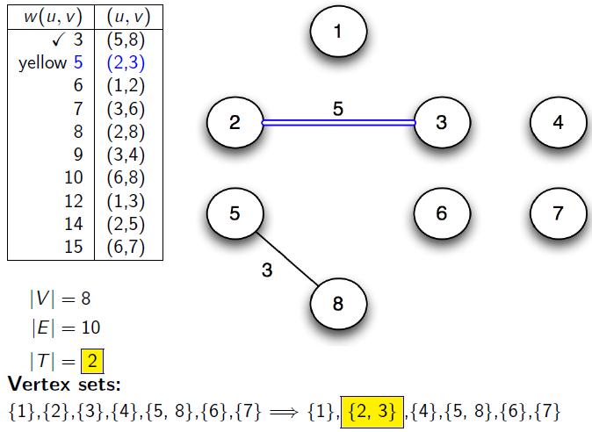
Kruskal’s algorithm in action

Slide 36
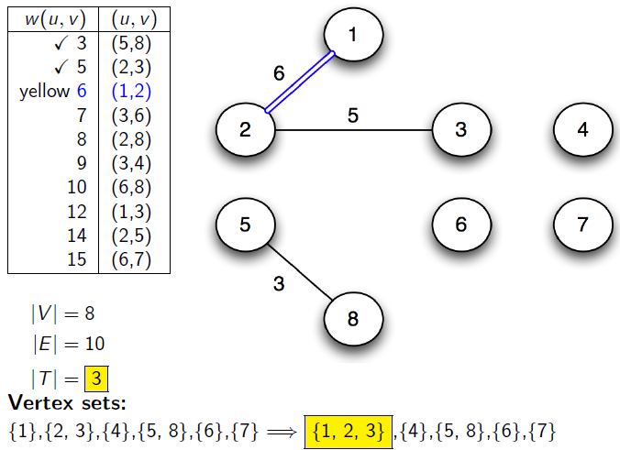
Kruskal’s algorithm in action

Slide 37
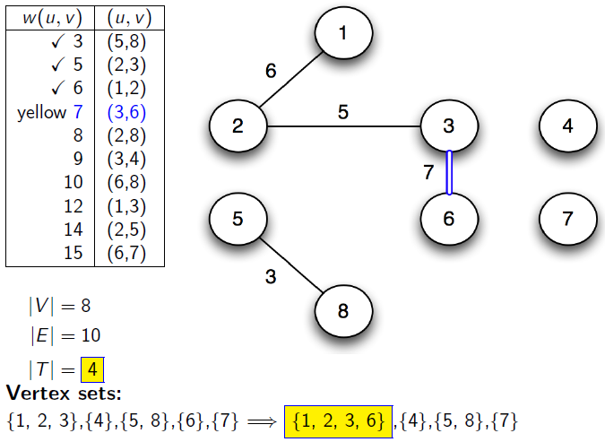
Kruskal’s algorithm in action

Slide 38
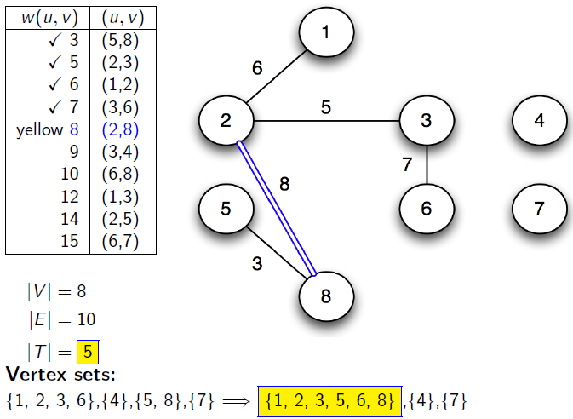
Kruskal’s algorithm in action

Slide 39
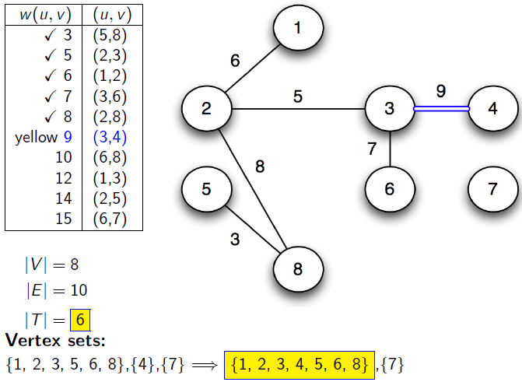
Kruskal’s algorithm in action

Slide 40
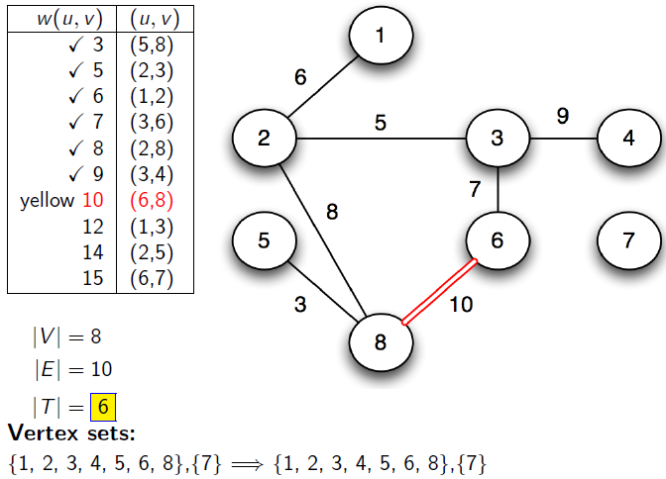
Kruskal’s algorithm in action

Slide 41
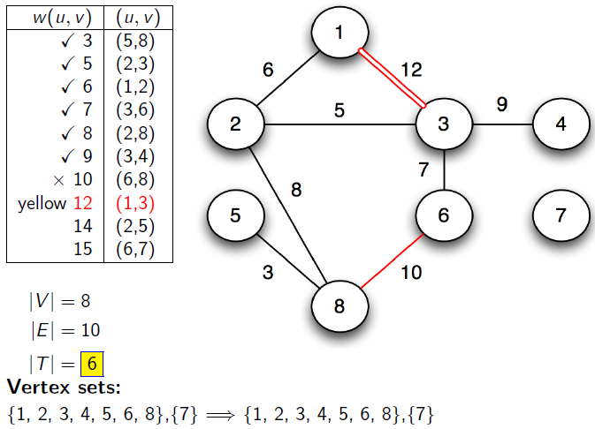
Kruskal’s algorithm in action

Slide 42
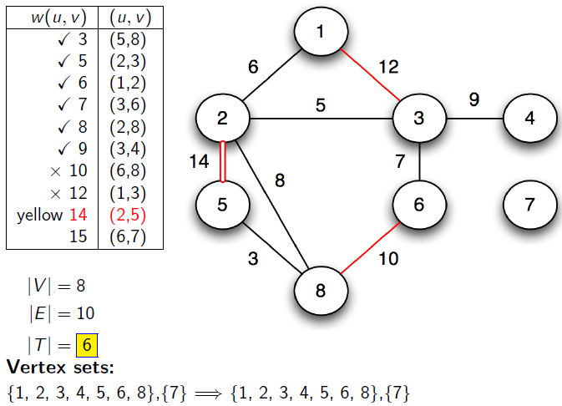
Kruskal’s algorithm in action

Slide 43
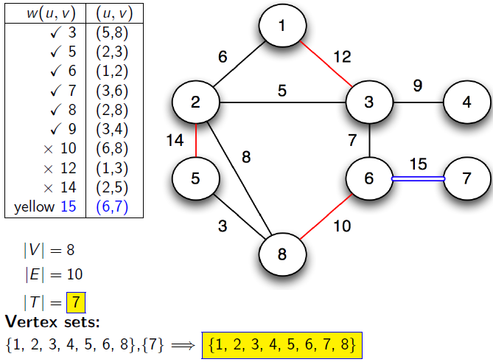
Kruskal’s algorithm in action

Slide 44
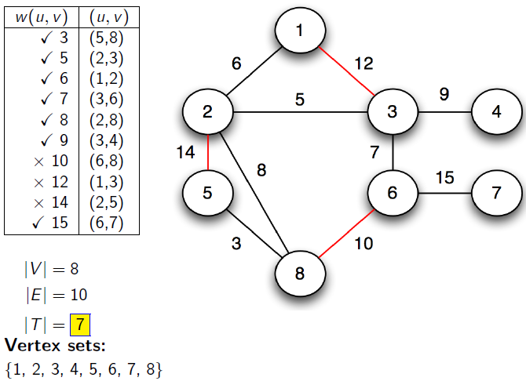
Kruskal’s algorithm in action

Slide 45
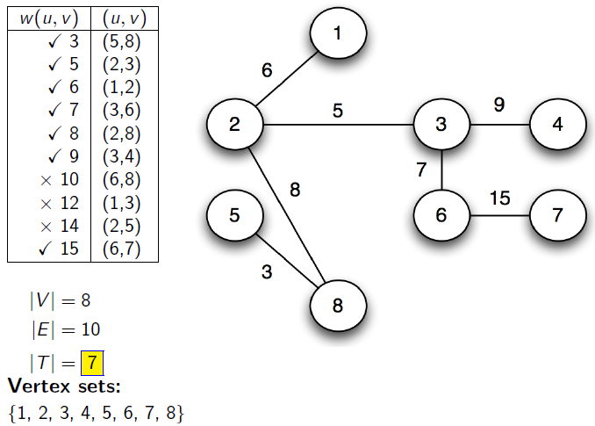
Kruskal’s algorithm in action

Slide 46
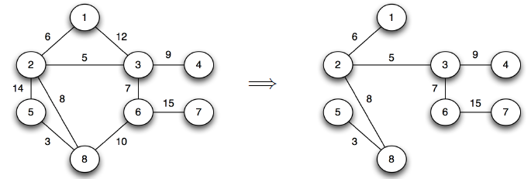
Kruskal’s algorithm in action

Slide 47
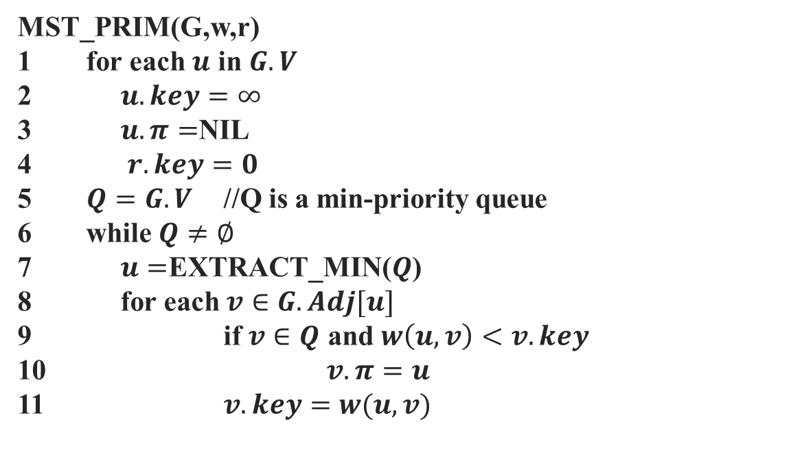
Prim's Algorithm
MST_PRIM(G,w,r)
1 for each $u$ in $G.V$
2 $u.key=∞$
3 $u.π=$NIL
4 $r.key=0$
5 $Q=G.V$ //Q is a min-priority queue
6 while $Q≠∅$
7 $u=$EXTRACT_MIN($Q$)
8 for each $v∈G.Adj[u]$
9 if $v∈Q$ and $w\left(u,v\right)<v.key$
10 $v.π=u$
11 $v.key=w(u,v)$

Slide 48
Prim's Algorithm
Grow the minimum spanning tree from the root vertex r.
Q is a priority queue, holding all vertices that are not in the tree now.
key[v] is the minimum weight of any edge connecting v to a vertex in the tree.
parent[v] names the parent of v in the tree.
When the algorithm terminates, Q is empty; the minimum spanning tree A for G is thus A={(v,parent[v]): v∈ V- {r} }.
Running time: O(E lg V).

Slide 49
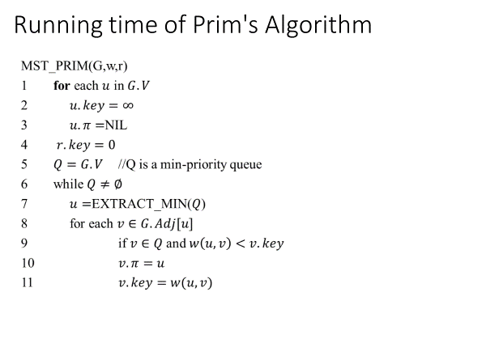
Running time of Prim's Algorithm
// O(V)
//Θ(V) time to build the heap
//V Heap-Extract-Min operations: O(V lg V)
//E Heap-Decrease-Key operations: O(E lg V)
Total time = O((V+E) lg V) = O(E lg V) since E ≥ V-1 => V is O(E)

Slide 50
Prim's Algorithm: Example
NIL,∞
8
NIL,∞
NIL,∞
the root vertex
c
7
d
b
9
4
NIL,∞
2
NIL,0
a
11
i
4
14
e
NIL,∞
7
6
8
10
h
g
f
NIL,∞
1
NIL,∞
2
NIL,∞

Slide 51
Prim's Algorithm: Example
a,4
8
NIL,∞
NIL,∞
c
7
d
b
9
4
NIL,∞
2
NIL,0
a
11
i
4
14
e
NIL,∞
7
6
8
10
h
g
f
a,8
1
NIL,∞
2
NIL,∞

Slide 52
Prim's Algorithm: Example
a,4
8
b,8
7
NIL,∞
b
c
d
9
4
NIL,∞
2
NIL,0
a
11
i
14
e
NIL,∞
4
7
6
8
10
h
g
f
a,8
1
NIL,∞
2
NIL,∞

Slide 53
Prim's Algorithm: Example
a,4
8
b,8
7
c,7
b
c
d
9
4
c,2
2
NIL,0
a
11
i
14
e
NIL,∞
4
7
6
8
10
h
g
f
a,8
1
NIL,∞
2
c,4

Slide 54
Prim's Algorithm: Example
a,4
8
b,8
7
c,7
b
c
d
9
4
c,2
2
NIL,0
a
11
i
14
e
NIL,∞
4
7
6
8
10
h
g
f
i,7
1
i,6
2
c,4

Slide 55
Prim's Algorithm: Example
a,4
8
b,8
7
c,7
b
c
d
9
4
c,2
2
NIL,0
a
11
i
14
e
f,10
4
7
6
8
10
h
g
f
i,7
1
f,2
2
c,4

Slide 56
Prim's Algorithm: Example
a,4
8
b,8
7
c,7
b
c
d
9
4
c,2
2
NIL,0
a
11
i
14
e
f,10
4
7
6
8
10
h
g
f
g,1
1
f,2
2
c,4

Slide 57
Prim's Algorithm: Example
a,4
8
b,8
7
c,7
b
c
d
9
4
c,2
2
NIL,0
a
11
i
14
e
f,10
4
7
6
8
10
h
g
f
g,1
1
f,2
2
c,4

Slide 58
Prim's Algorithm: Example
a,4
8
b,8
7
c,7
b
c
d
9
4
c,2
2
NIL,0
a
11
i
14
e
d,9
4
7
6
8
10
h
g
f
g,1
1
f,2
2
c,4

Slide 59
Prim's Algorithm: Example
a,4
8
b,8
7
c,7
b
c
d
9
4
c,2
2
NIL,0
a
11
i
14
e
d,9
4
7
6
8
10
h
g
f
g,1
1
f,2
2
c,4

Slide 60
Prim Algorithm:Variables
r:Grow the minimum spanning tree from the root vertex “r”.
Q: is a priority queue, holding all vertices that are not in the tree now.
key[v]: is the minimum weight of any edge connecting v to a vertex in the tree.
π [v]: names the parent of v in the tree.
T[v] – Vertex v is already included in MST if T[v]==1, otherwise, it is not included yet.
Removing v from set Q adds it to set Q-V of vertices in tree, thus adding (v, p[ v]) to A.

Slide 61
Prim Algorithm (2)
MST-Prim(G,r)
01 Q ← V[G] // Q – vertices out of T
02 for each u ∈ Q
03 key[u] ← ∞
04 key[r] ← 0 // r is the first tree node, let r=1
05 π[r] ← NIL
06 while Q ≠ ∅ do
07 u ← ExtractMin(Q) // making u part of T
08 for each v ∈ Adj[u] do
09 if v ∈ Q and w(u,v) < key[v] then
10 π[v] ← u
11 key[v] ← w(u,v)

Slide 62
The execution of Prim's algorithm
8
7
the root vertex
b
c
d
9
4
2
a
11
i
14
e
4
7
6
8
10
h
g
f
1
2
V | a | b | c | d | e | f | g | h | i
T | 1 | 0 | 0 | 0 | 0 | 0 | 0 | 0 | 0
Key | 0 | - | - | - | - | - | - | - | -
π | -1 | - | - | - | - | - | - | - | -

Slide 63
The execution of Prim's algorithm
8
7
the root vertex
b
c
d
9
4
2
a
11
i
14
e
4
7
6
8
10
h
g
f
1
2
V | a | b | c | d | e | f | g | h | i
T | 1 | 0 | 0 | 0 | 0 | 0 | 0 | 0 | 0
Key | 0 | 4 | - | - | - | - | - | 8 | -
π | -1 | a | - | - | - | - | - | a | -
63

Slide 64
The execution of Prim's algorithm
8
7
the root vertex
b
c
d
9
4
2
a
11
i
14
e
4
7
6
8
10
h
g
f
1
2
Important: Update Key[v] only if T[v]==0
V | a | b | c | d | e | f | g | h | i
T | 1 | 1 | 0 | 0 | 0 | 0 | 0 | 0 | 0
Key | 0 | 4 | 8 | - | - | - | - | 8 | -
π | -1 | a | b | - | - | - | - | a | -
64

Slide 65
The execution of Prim's algorithm
8
7
the root vertex
b
c
d
9
4
2
a
11
i
14
e
4
7
6
8
10
h
g
f
1
2
V | a | b | c | d | e | f | g | h | i
T | 1 | 1 | 1 | 0 | 0 | 0 | 0 | 0 | 0
Key | 0 | 4 | 8 | 7 | - | 4 | - | 8 | 2
π | -1 | a | b | c | - | c | - | a | c
65

Slide 66
The execution of Prim's algorithm
8
7
the root vertex
b
c
d
9
4
2
a
11
i
14
e
4
7
6
8
10
h
g
f
1
2
V | a | b | c | d | e | f | g | h | i
T | 1 | 1 | 1 | 0 | 0 | 0 | 0 | 0 | 1
Key | 0 | 4 | 8 | 7 | - | 4 | 6 | 7 | 2
π | -1 | a | b | c | - | c | i | i | c
66

Slide 67
The execution of Prim's algorithm
8
7
the root vertex
b
c
d
9
4
2
a
11
i
14
e
4
7
6
8
10
h
g
f
1
2
V | a | b | c | d | e | f | g | h | i
T | 1 | 1 | 1 | 0 | 0 | 1 | 0 | 0 | 1
Key | 0 | 4 | 8 | 7 | 10 | 4 | 2 | 7 | 2
π | -1 | a | b | c | f | c | f | i | c
67

Slide 68
The execution of Prim's algorithm
8
7
the root vertex
b
c
d
9
4
2
a
11
i
14
e
4
7
6
8
10
h
g
f
1
2
V | a | b | c | d | e | f | g | h | i
T | 1 | 1 | 1 | 0 | 0 | 1 | 1 | 0 | 1
Key | 0 | 4 | 8 | 7 | 10 | 4 | 2 | 1 | 2
π | -1 | a | b | c | f | c | f | g | c
68

Slide 69
The execution of Prim's algorithm
8
7
the root vertex
b
c
d
9
4
2
a
11
i
14
e
4
7
6
8
10
h
g
f
1
2
V | a | b | c | d | e | f | g | h | i
T | 1 | 1 | 1 | 0 | 0 | 1 | 1 | 1 | 1
Key | 0 | 4 | 8 | 7 | 10 | 4 | 2 | 1 | 2
π | -1 | a | b | c | f | c | f | g | c
69

Slide 70
The execution of Prim's algorithm
8
7
the root vertex
b
c
d
9
4
2
a
11
i
14
e
4
7
6
8
10
h
g
f
1
2
V | a | b | c | d | e | f | g | h | i
T | 1 | 1 | 1 | 1 | 0 | 1 | 1 | 1 | 1
Key | 0 | 4 | 8 | 7 | 9 | 4 | 2 | 1 | 2
π | -1 | a | b | c | d | c | f | g | c
70

Slide 71
The execution of Prim's algorithm
8
7
the root vertex
b
c
d
9
4
2
a
11
i
14
e
4
7
6
8
10
h
g
f
1
2
V | a | b | c | d | e | f | g | h | i
T | 1 | 1 | 1 | 1 | 1 | 1 | 1 | 1 | 1
Key | 0 | 4 | 8 | 7 | 9 | 4 | 2 | 1 | 2
π | -1 | a | b | c | d | c | f | g | c
71

Slide 72
Complexity: Prim Algorithm
MST-Prim(G,r)
01 Q ← V[G] // Q – vertices out of T
02 for each u ∈ Q
03 key[u] ← ∞
04 key[r] ← 0
05 π[r] ← NIL
06 while Q ≠ ∅ do
07 u ← ExtractMin(Q) // making u part of T
08 for each v ∈ Adj[u] do
09 if v ∈ Q and w(u,v) < key[v] then
10 π[v] ← u
11 key[v] ← w(u,v)
O(V)
O(V)
Heap: O(lgV)
Overall: O(E)
Decrease Key: O(lgV)
Overall complexity: O(V)+O(V lg V+E lg V) = O(E lg V)

Slide 73
Summary
Kruskal’s algorithm
Select the shortest edge in a network
Select the next shortest edge which does not create a cycle
Repeat step 2 until all vertices have been connected
Prim’s algorithm
Select any vertex
Select the shortest edge connected to that vertex
Select the shortest edge connected to any vertex already connected
Repeat step 3 until all vertices have been connected

Slide 74
Summary
Both are greedy algorithms
Both have the same output→ MST
Kruskal’s begins with forest and merge into a tree
Prim’s always stays as a tree

Slide 75
Books
Introduction to Algorithms, Thomas H. Cormen, Charle E. Leiserson, Ronald L. Rivest,
Clifford Stein (CLRS).
Fundamental of Computer Algorithms, Ellis Horowitz, Sartaj Sahni,
Sanguthevar Rajasekaran (HSR)

Slide 76
References
https://www.geeksforgeeks.org/kruskals-minimum-spanning-tree-algorithm-greedy-algo-2/
https://www.geeksforgeeks.org/applications-of-minimum-spanning-tree/
https://www.tutorialspoint.com/data_structures_algorithms/prims_spanning_tree_algorithm.htm
https://www.tutorialspoint.com/data_structures_algorithms/kruskals_spanning_tree_algorithm.htm
https://www.cs.usfca.edu/~galles/visualization/Prim.html
https://visualgo.net/en/mst?slide=1

